Slide 1
Capstone Project - 2
Team: Reality
NETFLIX MOVIES AND TV SHOWS CLUSTERING
Team Members
AYUSH JAIN
DHONGARI PAVAN
NADEEHA A
ROMALY DAS
SREENIVASAN KV
YASH PATIL

Slide 2
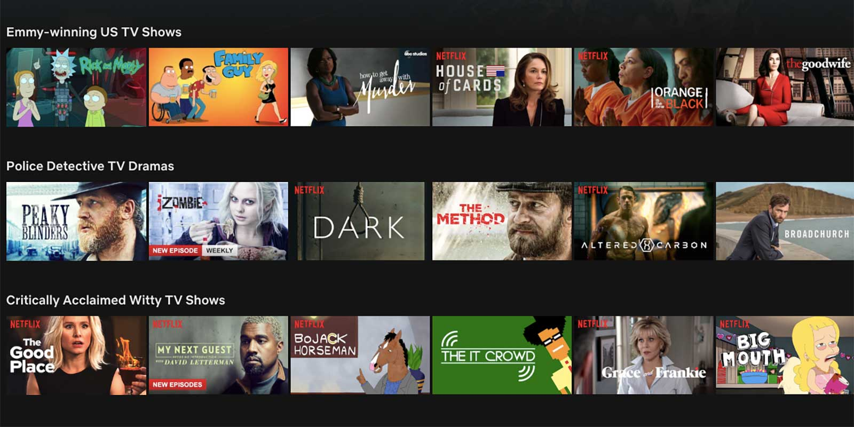


Slide 3
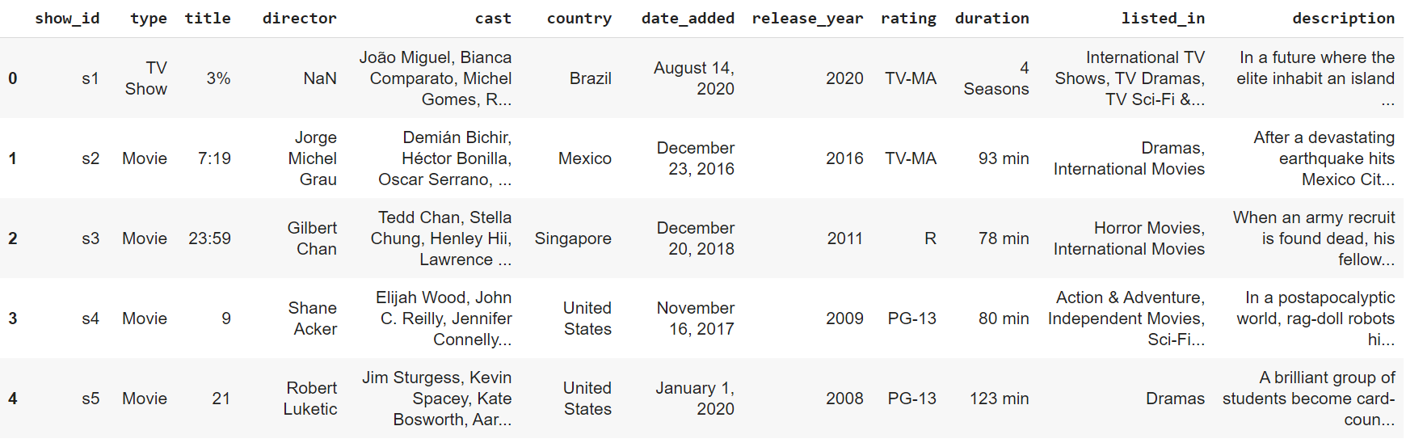
Dataframe from our Netflix Dataset

Slide 4
What is expected from this project?
Exploratory Data Analysis
Understanding what type of content is available in different Countries
Is Netflix has increasingly focussed on TV rather than Movies in recent years?
Clustering similar content by matching text based features.

Slide 5
Closer look at the dataset..!!
The data was collected from Flixable which is third party Netflix search engine. The dataset consists of movies and TV shows data till 2019. The dataset has 7787 rows of data.
The dataset consists of eleven textual columns and one numeric column.
Show id:- It is unique for all the movies/tv shows.
Type :- Type of content i.e movie/tv show.
Title :- Name of the movie/tv show.
Director :- Name of the director

Slide 6
Closer look at the dataset..!!
Cast:- Actors involved in the movie/tv show.
Country :- Country where the movie/tv show is produced.
Data added :- Date when movie/tv show is added to Netflix.
Release year :- Year when the movie was released.
Rating :- Content rating.
Listed_in :- Genres of the movie/tv show.
Description :- The summary of the movie/tv show.
Duration :- total duration of movie in minutes/ seasons for tv shows.

Slide 7
Closer look at the dataset..!!
There are 2389 null values in Director column
There are 718 null values in cast column
There are 507 null values in country column
There are 10 null values in date added column
There are 7 null values in rating column

Slide 8
Exploratory Data Analysis

Slide 9
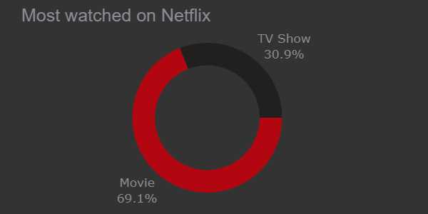
TV or Movie Shows?
There are 5377 movies and 2410 tv shows.

Slide 10
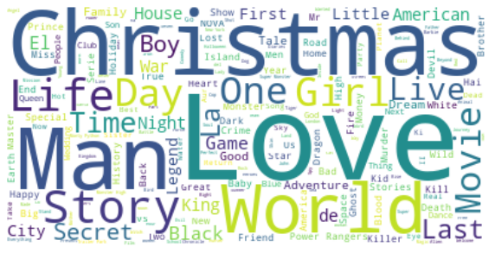
Common Titles!
It seems like words like "Love", "Man", "World", "Story" are very common in titles.

Slide 11
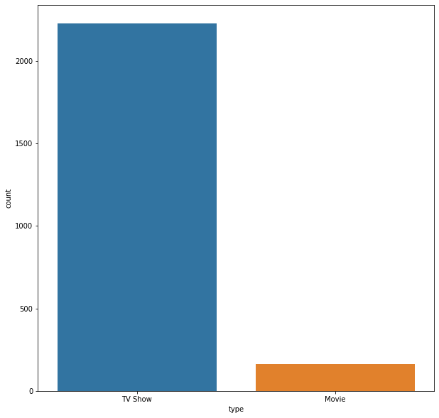
EDA (Continued..)
It looks like most of the missing values of Director is for tv shows.

Slide 12
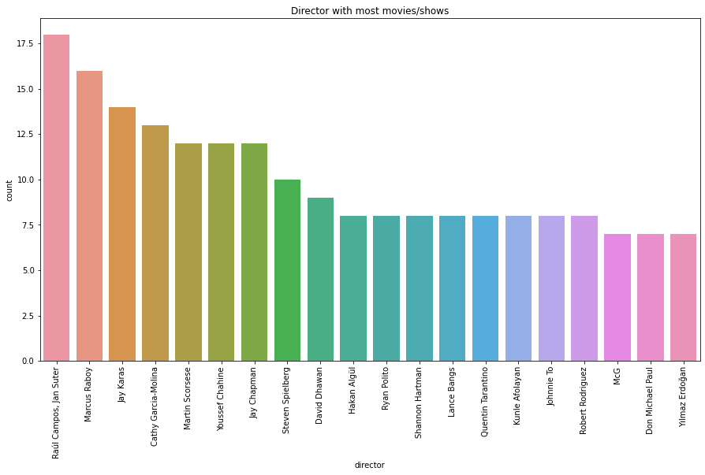
EDA (Continued..)

Slide 13
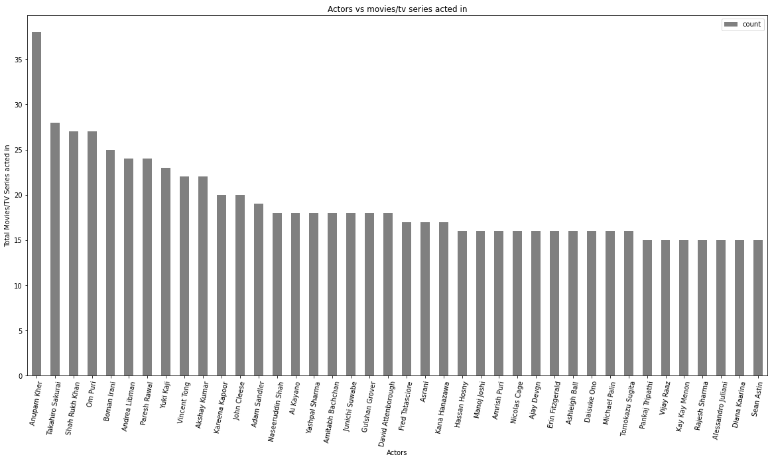
EDA (Continued..)

Slide 14
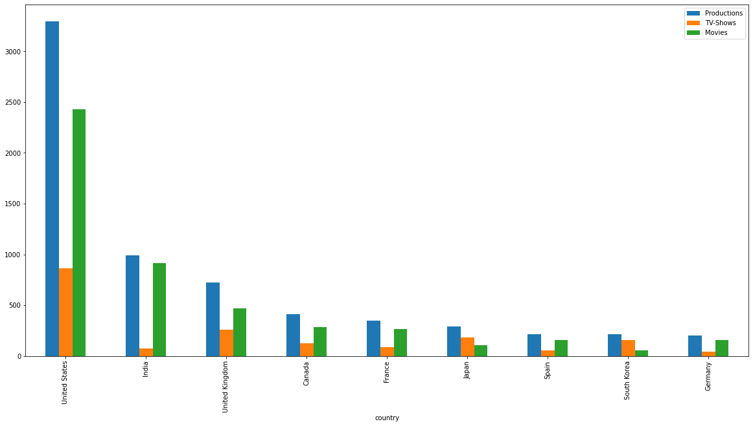
Production split across top countries

Slide 15
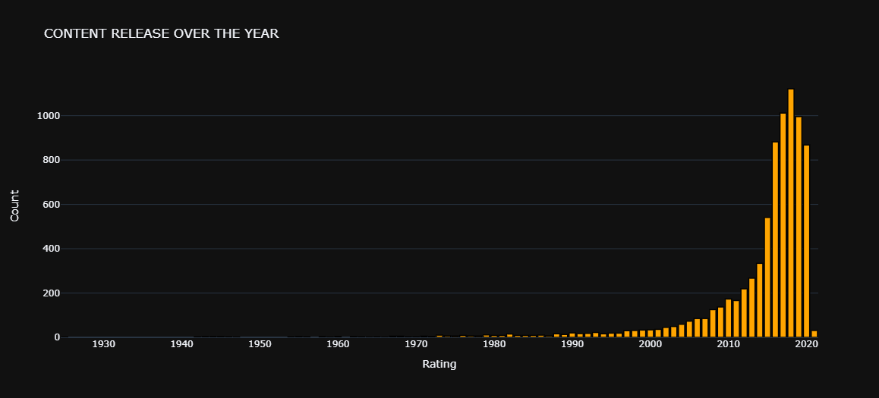
Releases over the year!

Slide 16
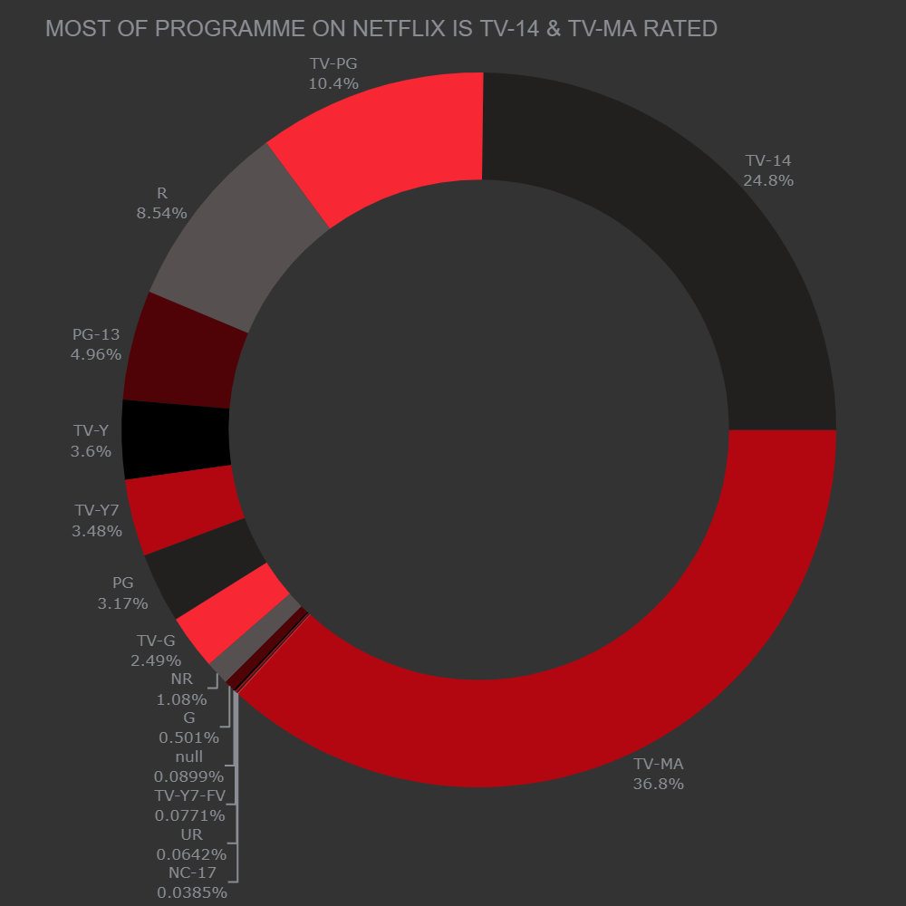
Split of content ratings..

Slide 17
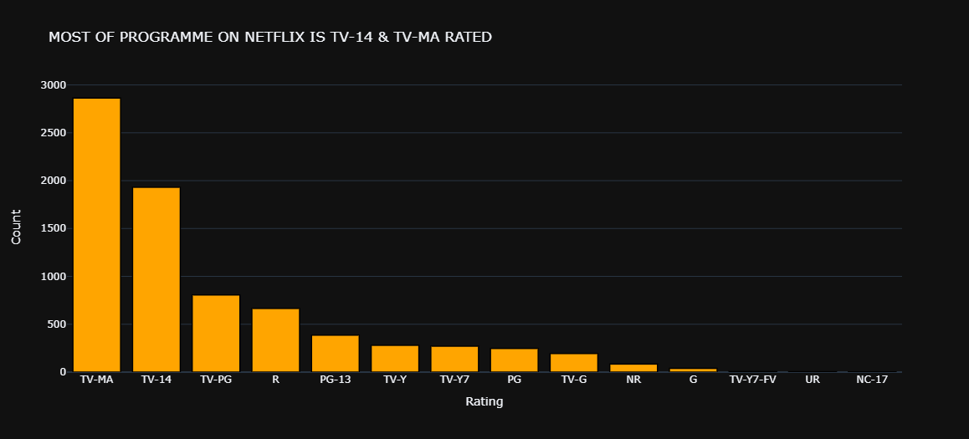
Split of content ratings..

Slide 18
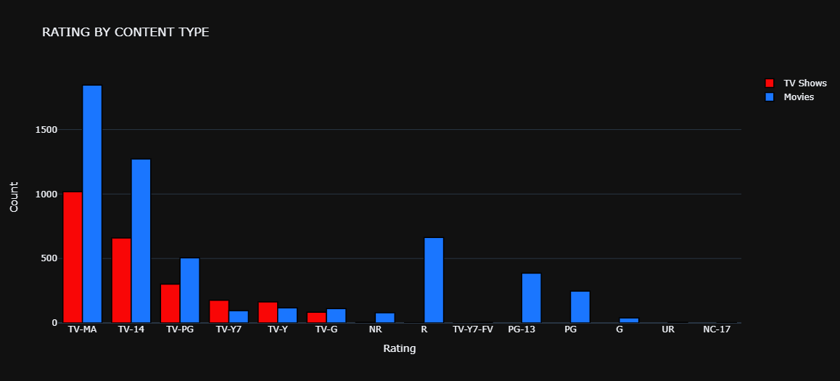
Split of content ratings..

Slide 19
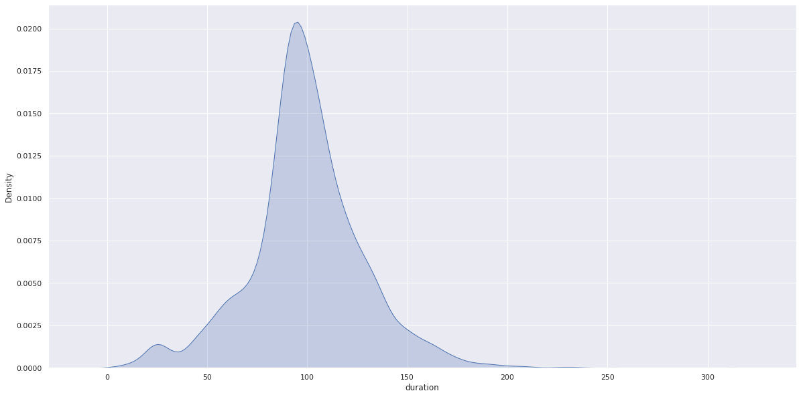
Duration distribution of Movies

Slide 20
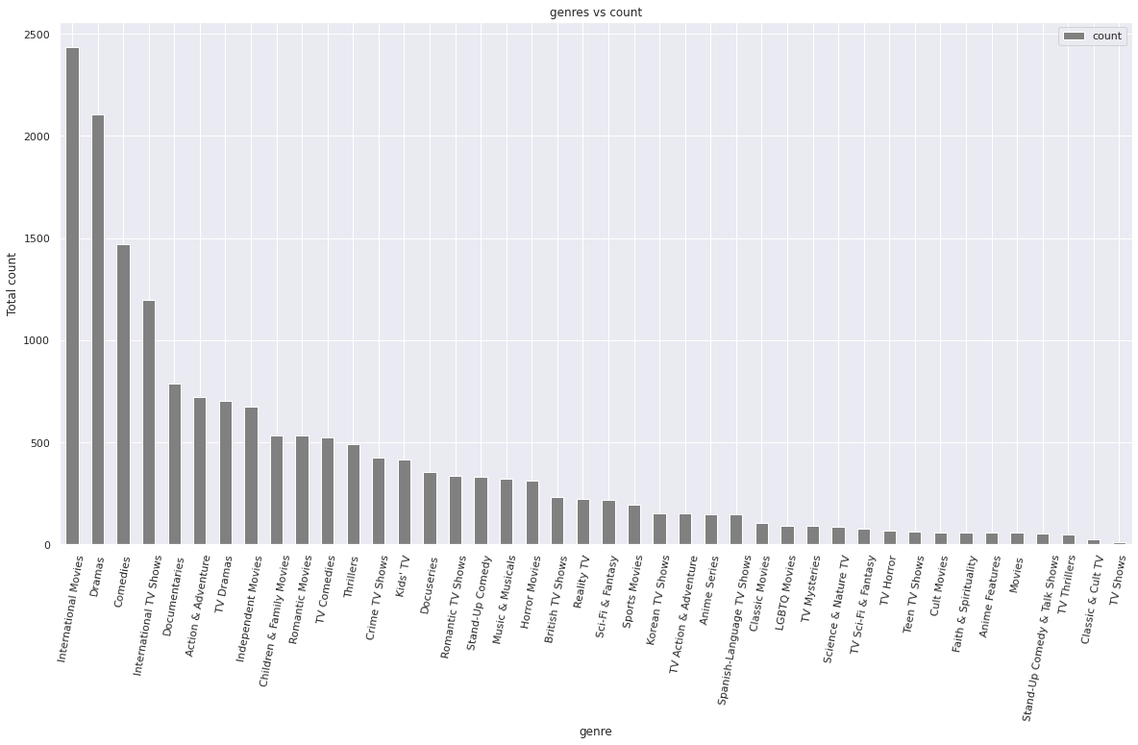
Top Genre..!!

Slide 21
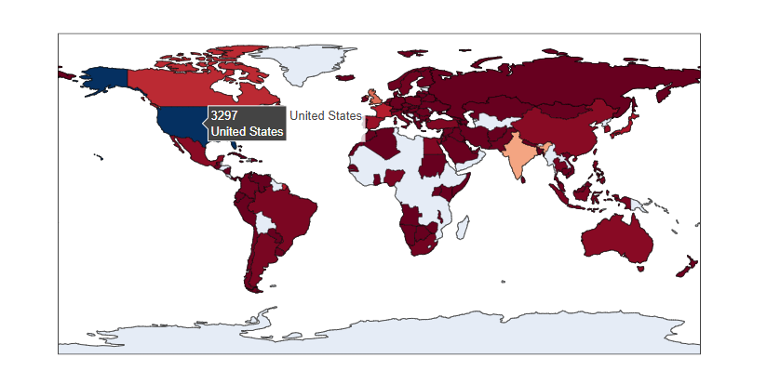
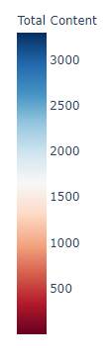
Content produced by Countries
Number of content produced by different countries

Slide 22
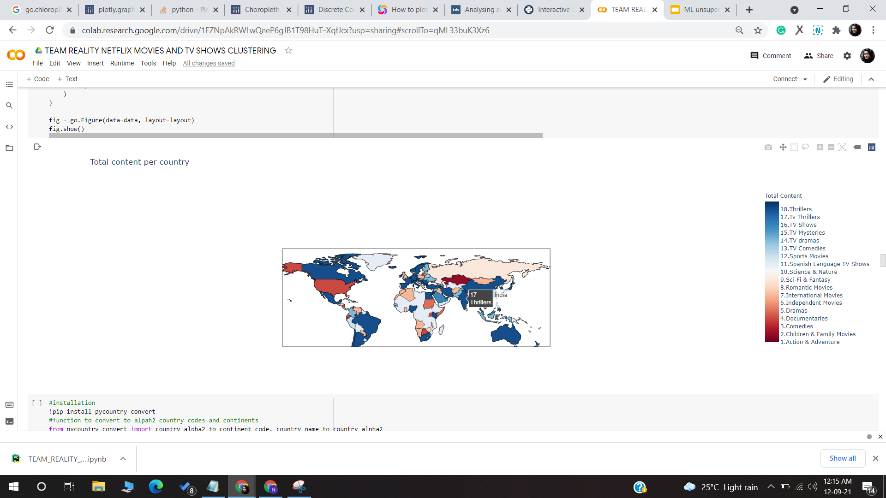
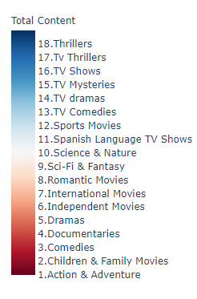
Genre across different Countries
Genre preferred by different countries

Slide 23
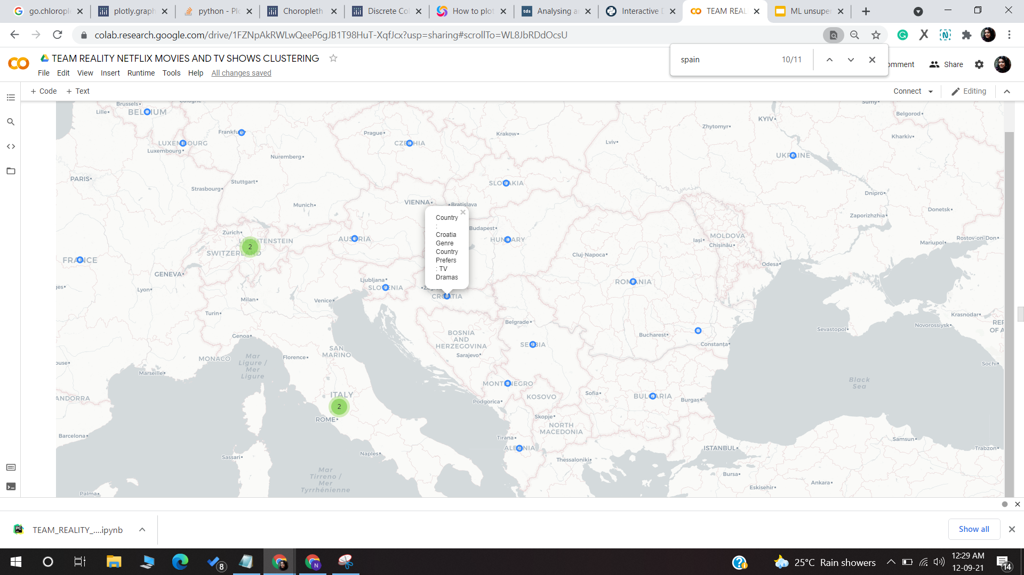
Genre across different Countries

Slide 24
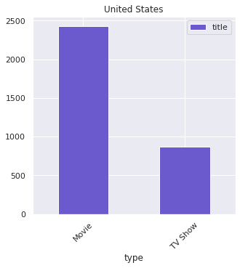
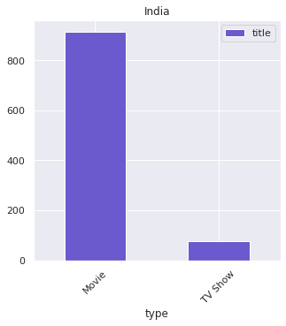
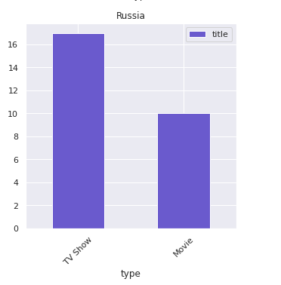
Russia, US & India: Movies or Shows?
Release of TV shows as compare to Movies are more in Russia as compare to India and US

Slide 25
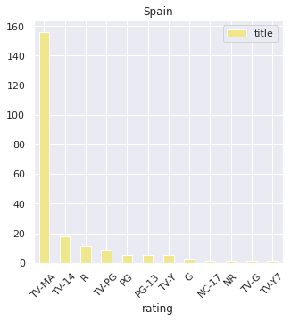
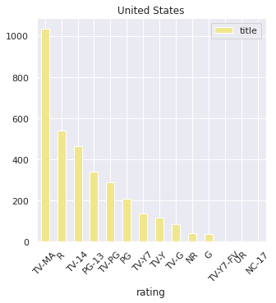
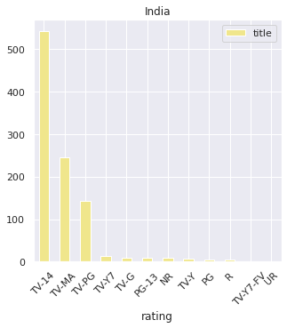
Spain, US & India: Rating
Spain and US prefers TV-Mature content, while India prefers TV -14 ( unsuitable for children under the age of 14)

Slide 26
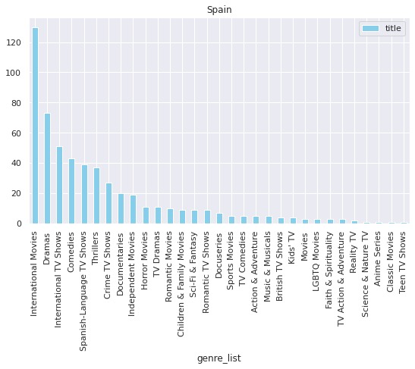
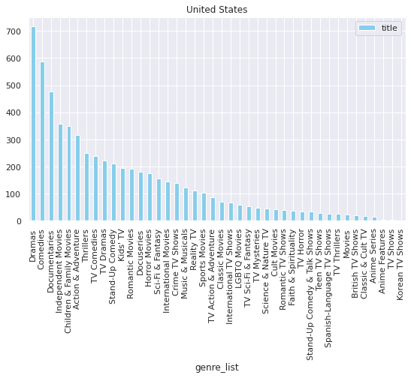
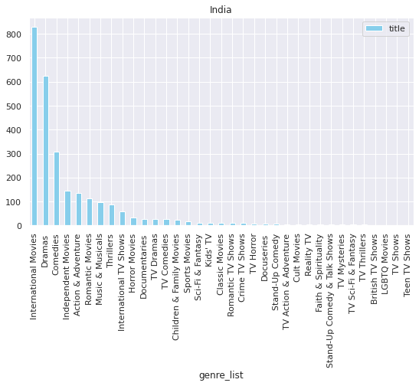
Spain, US & India: Genre
Spain & India has more International Movies, while US has more Drama Content.

Slide 27
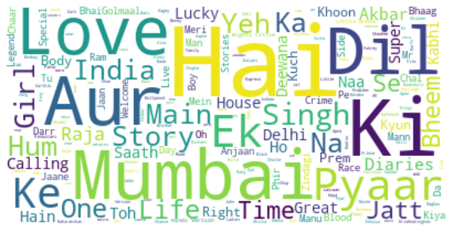
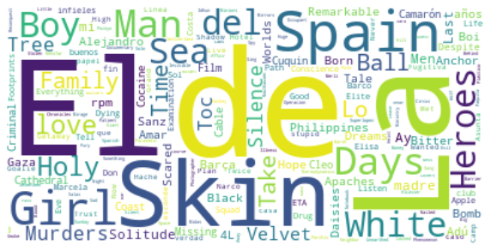
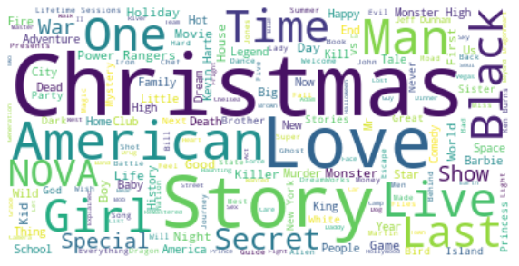
Spain, US & Indian: Titles!

Slide 28
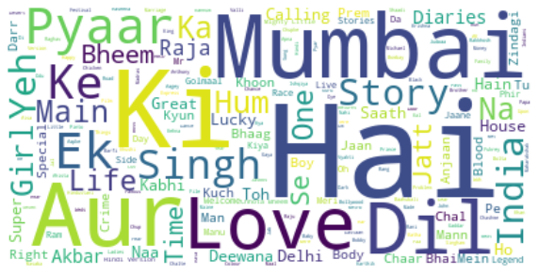
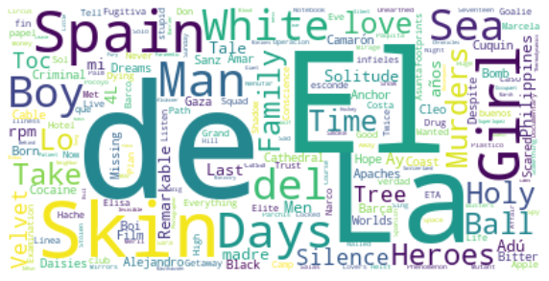
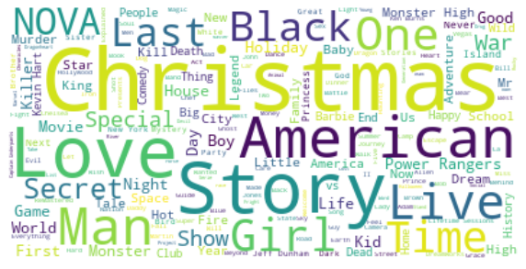
Spain, US & Indian: Description!

Slide 29
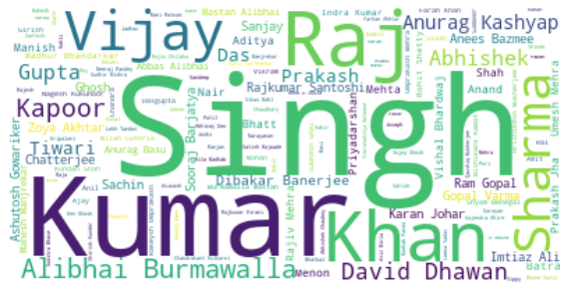
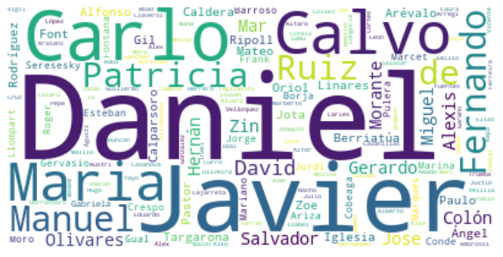
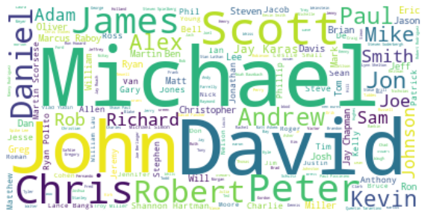
Which Director to choose?

Slide 30
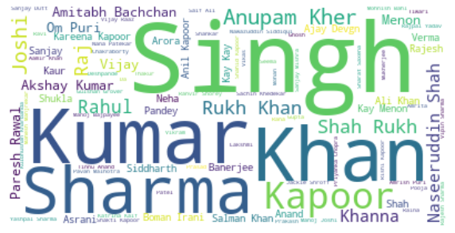
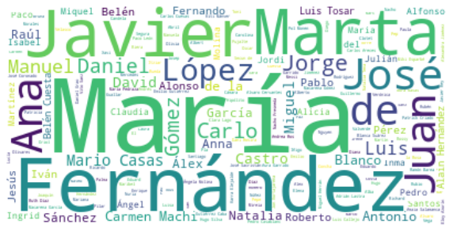
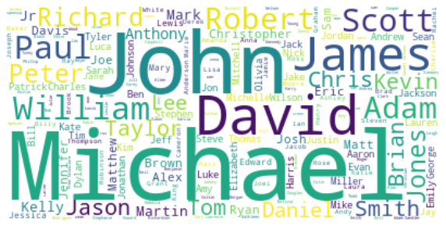
Actors preferred!

Slide 31
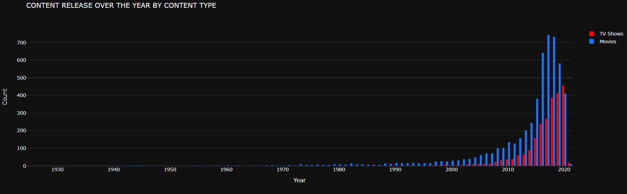
Is Netflix focusing more on TV Shows/Movies

Slide 32
Clustering dataset - Text Features

Slide 33
Text Preprocessing!
CLEANING
2. STOPWORDS
3. TOKENIZATION
4. STEMMING
Cleaned Null values
All Columns: Only characters selected by regex
All words to lowercase
Merged text columns
Removed Stop words
Normal english words & problem specific
Splitted sentences to tokens
Used word_tokenise from nltk
Transformed words to roots
Used Snowball Stemmer
Everybody stand back, I know regex expressions!

Slide 34
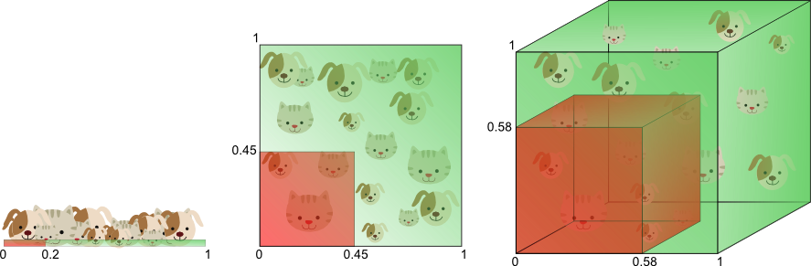
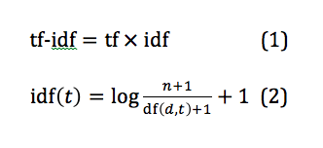
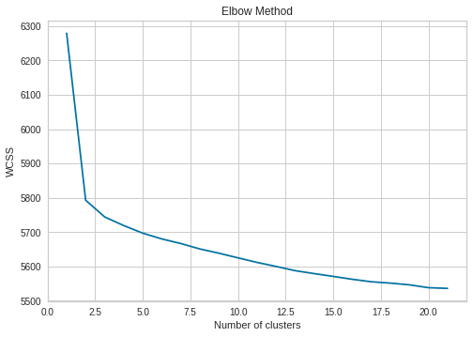

Time to Cluster..
Vectorization
Dimensionality Reduction
Finding Optimal K
K - Means Clustering with Optimal k
TFIDF Vectorizer
PCA
Elbow method: WCSS, Silhouette score
What could we infer?

Slide 35
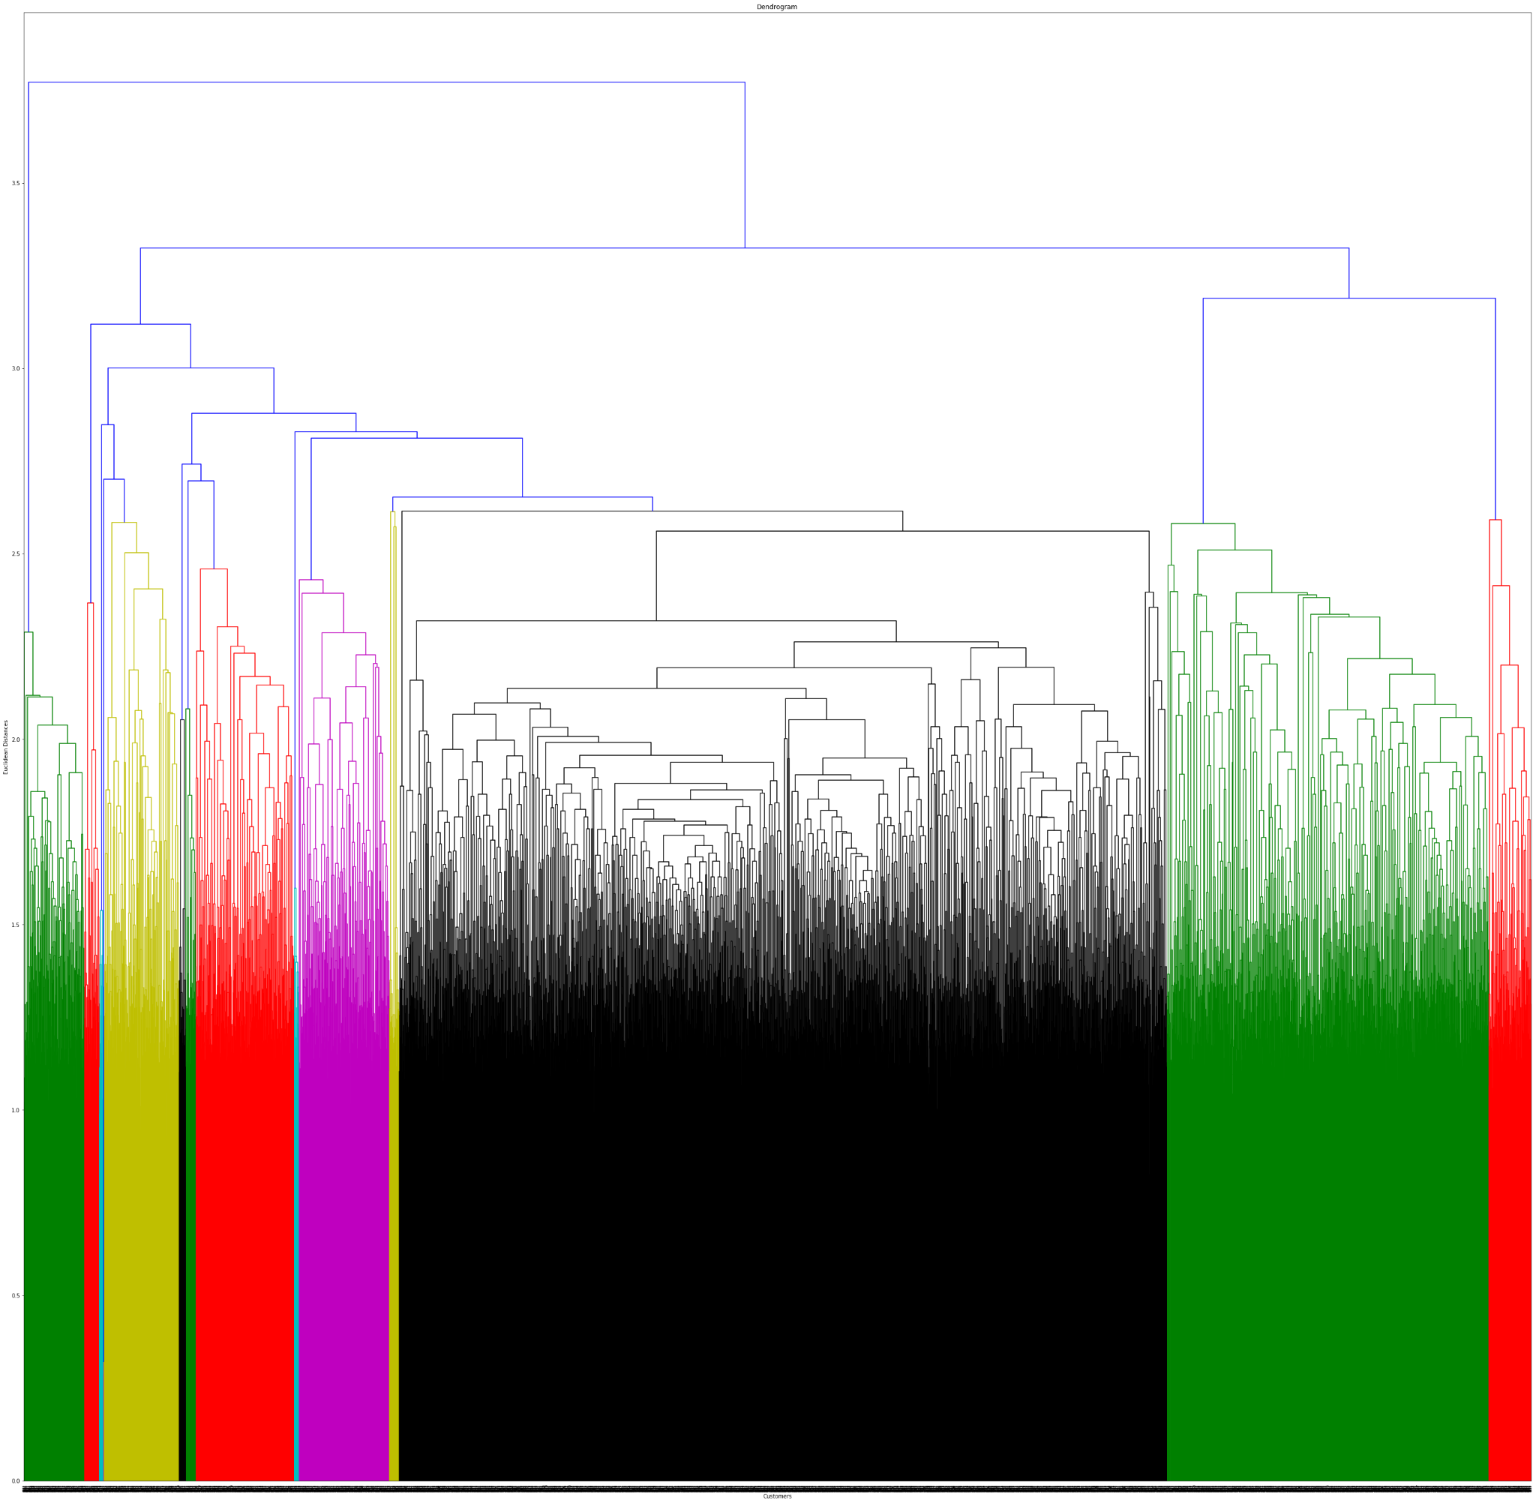
Dendrogram..

Slide 36
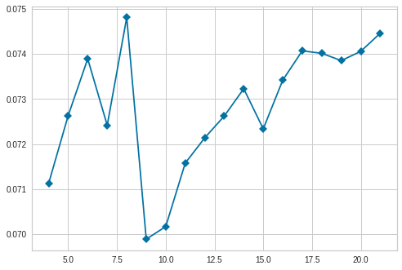
Finding Optimal K!

Slide 37
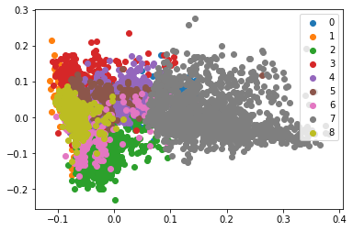
Visualizing Clusters for k=9

Slide 38
Naming the clusters
0: Kids, Animation & Anime
1: Musical International & Indian
2: Drama, International, Indian
3: Documentaries, Sports
4: Drama, American, Adventure
5: Comedy
6: Horror
7: International TV Shows
8: Family Movies

Slide 39
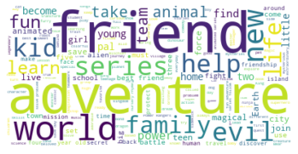

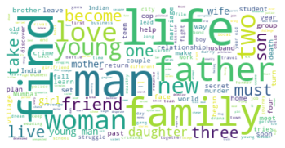
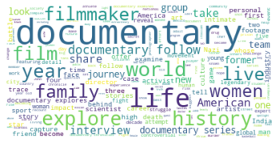





Clusters: Description
C-0(Kids) C-1(Musical) C-2(Drama)
C-3(Documentary) C-4(American) C-5(Comedy)
C-6(Horror) C-7(TV Shows) C-8(Family)

Slide 40









Cluster: Cast
C-0 C-1(Indian) C-2(Indian)
C-0 C-1 C-2
C-3 C-4 C-5
C-6 C-7(International) C-8

Slide 41









Cluster: Titles!
C-0 C-1 C-2
C-3 C-4(American) C-5
C-6 C-7 C-8

Slide 42


Slide 43


Slide 44

Recommendation System for Netflix..!!

Slide 45

If only we had more time: Future Scope!
Integrate Netflix dataset with other data set and present more insights and clusters.
We could have done some research on recommendation system.

Slide 46

Conclusion
Performed EDA
Univariate & multivariate analysis
Visualised Data, inferred insights
Analysed various trends in Countries
TV Shows or Movies?
Text Based Clustering
Identified 9 distinct clusters
Experimented Interacted Visualisations
Recommendation System

Slide 47

Suggestions
“Torture the data, and it will confess to anything.”
-Ronald Coase, Nobel Prize winner

Slide 48

Time for Q&A!!

